Slide 1

Teradata
An Introduction to internal working

Slide 2
What is Teradata?
Best Data warehouse & analytical database
Fully scalable relational database management system
It has a capacity of Teradata bytes in size which makes it a market leader in data warehousing application
It is one of the largest systems in the world
It was an extension for mainframe systems

Slide 3
Teradata components
Processor Chip
1
Memory
2
Hard Drives
3
BRAIN of the Teradata system
HAND of Teradata system
SPINE of Teradata system
Notes:
Source: http://www.teradatatech.com/?p=101
Processor Chip – The processor is the BRAIN of the Teradata system. It is responsible for all the processing done by the system. All task are done according to the direction of the processor.
Memory – The memory is known as the HAND of the Teradata system. Data is retrieved from the hard drives into memory, where processor manipulates, change or alter the data. Once changes are made in memory, the processor directs the information back to the hard drive for storage.
Hard Drives – This is known as the SPINE of the Teradata system. All the data of the Teradata system is stored in the hard drives. Size of hard drives reflects the size of the Teradata system.

Slide 4
Why Teradata?
Large capacity
Performance
Single version of truth
Manageable growth
Fault Tolerance
Notes:
Large capacity - Supports large volume of data for decision support systems ( Billions of rows, teradata bytes of data)
Performance - Provides better performance through parallelism
Single version of truth - Data can be accessed by different hosts instead of replicating the data in different hosts
Manageable growth - Support linear scalability by adding additional nodes without affecting performance
Fault Tolerance - Automatically recovers from major hardware failures

Slide 5
Advantages of Teradata
Scalability
Parallel Efficiency
Execution of complex queries with a maximum of 256 joins
Support Ad-hoc queries
Support concurrent users

Slide 6
Teradata Competitive Advantages
Linear Scalability
Unlimited Parallelism
Mature Optimizer
Easy Setup
Load & Unload utilities
Notes:
Source: https://www.youtube.com/watch?v=wA935nTdScM&t=3469s
Linear Scalability: Large volume of data and a number of users are present. Adding nodes will increase the capacity/ performance of the system
Unlimited parallelism: Teradata is based on massively parallel architecture and it is designed to be parallel since beginning. MPP systems divide large task into smaller tasks and run them in parallel
Mature Optimizer: Teradata Optimizer has been fine tuned throughout its history. It can handle up to 64 joins in a query.
Low CTO: Easy setup, administration and maintenance
Load & Unload Utilities: Teradata provides robust load & unload utilities to move data into/from Teradata system.

Slide 7
How Teradata tracks object?
Teradata Assigns each Object a Unique Numeric ID such as database names, table names and column names
Each Table, View, Macro, Trigger, Stored Procedure, User-defined Function, Join Index, and Hash Index is assigned their own globally unique numeric ID.
Each Column is assigned a numeric ID that is unique within its Table ID.
Each Index is assigned a numeric ID unique within its Table ID.
The Data Dictionary keeps track of all the SQL names and their associated numeric IDs.
The PE uses the Data Dictionary to verify names and then the PE convert them to IDs.
The AMPs use the numeric IDs supplied by the Parsing Engine in its Data Dictionary RESOLVER logic. The PE Resolver resolves that the object names exist in the Data Dictionary.
Notes:
Source: Teradata Database Administration by Coffing

Slide 8
Indexes
Unique Primary Index
Non Unique Primary Index
Multi Column Primary Index
No Primary Index Tables

Slide 9
Parsing Engine
Notes:
Source: http://www.teradatawiki.net/2013/08/Teradata-Parsing-engine.html
The Session Control component verifies the request for session authorization (user names and passwords), and either allows or disallows the request. The Parser does the following: Interprets the SQL statement received from the application.
Verifies SQL requests for the proper syntax and evaluates them semantically.
Consults the Data Dictionary to ensure that all objects exist and that the user has authority to access them.
The Optimizer is cost-based and develops the least expensive plan (in terms of time) to return the requested response set.The optimizer must know about system configuration, available units of parallelism (AMPs and PE's), and data demographics. The Teradata Optimizer is robust and intelligent. The optimizer enables Teradata to handle multiple complex, ad hoc queries efficiently. It is parallel-aware and cost-based and uses full look-ahead capability. The Dispatcher controls the sequence in which the steps are executed and passes the steps received from the optimizer onto the BYNET for execution by the AMPs.
Access Module Processor (AMP) − AMPs, called as Virtual Processors (vprocs) are the one that actually stores and retrieves the data. AMPs receive the data and execution plan from Parsing Engine, performs any data type conversion, aggregation, filter, sorting and stores the data in the disks associated with them. Records from the tables are evenly distributed among the AMPs in the system. Each AMP is associated with a set of disks on which data is stored. Only that AMP can read/write data from the disks.

Slide 10
Session Control
The Session Control component verifies the request for session authorization (user names and passwords), and either allows or disallows the request.

Slide 11
Parser
The Parser does the following: Interprets the SQL statement received from the application.
Verifies SQL requests for the proper syntax and evaluates them semantically.
Consults the Data Dictionary to ensure that all objects exist and that the user has authority to access them.

Slide 12
Optimizer
Cost-based and develops the least expensive plan (in terms of time) to return the requested response set
Knows about system configuration, available units of parallelism (AMPs and PE's), and data demographics.
Robust and intelligent
Handles multiple complex, ad hoc queries efficiently.
Parallel-aware and cost-based
Uses full look-ahead capability

Slide 13
Dispatcher
The Dispatcher controls the sequence in which the steps are executed
Passes the steps received from the optimizer onto the BYNET for execution by the AMPs

Slide 14
Access Module Processor (AMP)
AMPs, called as Virtual Processors (vprocs) are the one that actually stores and retrieves the data.
Point to point – message is routed to Single AMP
Multi-cast – message is routed to multiple AMP
Broadcast – Message is routed to all AMPs
Notes:
AMP is responsible for storing and retrieving rows. It stores the data in the virtual disk associated with it. In addition to this, AMP is responsible for lock management, space management, sorting and aggregation.
AMPs receive the data and execution plan from Parsing Engine, performs any data type conversion, aggregation, filter, sorting and stores the data in the disks associated with them. Records from the tables are evenly distributed among the AMPs in the system. Each AMP is associated with a set of disks on which data is stored. Only that AMP can read/write data from the disks.

Slide 15
BYNET
All communication between PEs and AMPs is done via the BYNET
BYNET receives the execution plan from the Parsing Engine and dispatches to the appropriate AMP
Each AMP or PE can use one BYNET to retrieve communication and simultaneously accept messages using the other BYNET
Notes:
Source: https://www.tutorialspoint.com/teradata/teradata_questions_answers.htm
http://www.teradatawiki.net/2013/08/Teradata-BYNET.html
AMPs receive the data and execution plan from Parsing Engine, performs any data type conversion, aggregation, filter, sorting and stores the data in the disks associated with them. Records from the tables are evenly distributed among the AMPs in the system. Each AMP is associated with a set of disks on which data is stored. Only that AMP can read/write data from the disks.

Slide 16
BYNET Features
Scalable
1
High performance
2
Fault tolerant
3
Load balanced
4
Notes:
http://www.teradatawiki.net/2013/08/Teradata-BYNET.html
Scalable: As you add more nodes to the system, the overall network bandwidth scales linearly. This linear scalability means you can increase system size without performance penalty -- and sometimes even increase performance. High performance: An MPP system typically has two BYNET networks (BYNET 0 and BYNET 1). Because both networks in a system are active, the system benefits from having full use of the aggregate bandwidth of both the networks. Fault tolerant: Each network has multiple connection paths. If the BYNET detects an unusable path in either network, it will automatically reconfigure that network so all messages avoid the unusable path. Additionally, in the rare case that BYNET 0 cannot be reconfigured, hardware on BYNET 0 is disabled and messages are re-routed to BYNET 1. Load balanced: Traffic is automatically and dynamically distributed between both BYNETs.

Slide 17
What is FALLBACK?
FALLBACK is a protection mechanism used by Teradata to handle AMP failures.
For each data row, another copy of the row is stored in a different AMP within a cluster.
If any AMP fails, then the corresponding rows will be accessed using FALLBACK AMP.
FALLBACK can be mentioned while table creation using CREATE TABLE statement or after the table is created using ALTER TABLE statement.

Slide 18
Other Features

Slide 19
Data Blocks
Each Table Header and Data Block have the Same TableID
Each Data Block starts with a 72 Byte Data Block Header
AMPs Moves Their Data Blocks into Memory to Read/Write
Data Blocks Grow until they Reach Maximum Block Size
Blocks Continue to Split as Tables Grow Larger
Notes:
When an AMP wants to read its rows it moves the entire data block from its disk into its FSG Cache memory and then it reads the rows. Moving the block from disk into memory is called an I/O (Input/Output).
Rows of a table can't be read on disk. The rows are merely stored on disk in their data blocks. When a Full Table Scan (for example) needs to read all rows of a table, the AMPs will simultaneously move their data block into their FSG Cache memory.
Data Blocks Grow until they Reach Maximum Block Size: As data is added, Teradata continues to grow the block one 512 byte sector at a time. Once the block grows to the maximum block size, then Teradata will split the single block into two separate blocks. The default for the split is 255 sectors or 127 KB.

Slide 20
Data Protection
Teradata uses Transient Journal to protect data from transaction failures.
Fallback protects the table data by storing the second copy of rows of a table
The Down AMP recovery journal is activated when the AMP fails and the table is fallback protected
Clique is a mechanism used by Teradata to protect data from Node failures
Hot Standby Node is a node that does not participate in the production environment
Redundant Array of Independent Disks (RAID) is a mechanism used to protect data from Disk Failures
Notes:
Source https://www.tutorialspoint.com/teradata/teradata_data_protection.htm

Slide 21
Performance Tuning
EXPLAIN
COLLECT STATISTICS
Proper data types are used
Avoid explicit data conversions
Remove unnecessary ORDER BY clauses unless required
Spool space error is generated if the query exceeds per AMP spool space limit for that user
Drop the temporary tables (staging tables) and volatiles if they are no longer needed.
Notes:
Source: https://www.tutorialspoint.com/teradata/teradata_performance_tuning.htm

Slide 22
FastLoad
Target table should be empty
Only one table can be loaded using a single script
Supports only CREATE/INSERT statement
Doesn’t support tables with RI, SI and Triggers
Notes:
FastLoad provides restart capability through checkpoints. When the script is restarted from the last checkpoint, it is possible that the same rows may be sent again to the AMPs. That’s the reason FastLoad doesn’t support duplicates.

Slide 23
FastLoad
Phase 1
Phase 2
it brings the data in 64K blocks and sends them to the target AMPs. Each AMP will then hash redistribute the rows to their target AMPs.
rows are sorted by their row hash order and written into the target table.
Notes:
FastLoad provides restart capability through checkpoints. When the script is restarted from the last checkpoint, it is possible that the same rows may be sent again to the AMPs. That’s the reason FastLoad doesn’t support duplicates.

Slide 24
MultiLoad
Target table need not be empty
Can load/update up to 5 tables
Supports up to 20 DML statements in single script
Supports tables with NUSI

Slide 25
MultiLoad Phases
Phase 1
Preliminary Phase – Performs basic setup activities.
Phase 2
DML Transaction Phase – Verifies the syntax of DML statements and brings them to Teradata system.
Phase 3
Acquisition Phase – Brings the input data into work tables and locks the table.
Phase 4
Application Phase – Applies all DML operations.
Phase 5
Cleanup Phase – Releases the table lock.

Slide 26
Fast Export
FastExport utility is used to export data from Teradata tables into flat files.
It can also generate the data in report format. Data can be extracted from one or more tables using Join.
Since FastExport exports the data in 64K blocks, it is useful for extracting large volume of data.
Script: fexp < employee.fx
Notes:
https://www.tutorialspoint.com/teradata/teradata_fastexport.htm

Slide 27
Parallel Processing
Pioneer in parallel processing since 1988
Parallelism is built into its Data Structure
Other levels of parallelism are imposed by the optimizer when building query plans
Optimizer can choose to execute multiple steps within the same query at same time
Notes:
https://www.youtube.com/watch?v=AUPpobtWUyU
Teradata is built to max throughput request every user request

Slide 28
Notes:
Source: Teradata database Administration by Coffing

Slide 29
Notes:
Let’s look at the Teradata Architecture again

Slide 30
Linear Scalability
There is no limit to Linear Scalability
Add AMPs to double its speed for Linear Scalability
It is also known as ‘DIVIDE and CONQUER’ theory, according to which we are dividing the work equally and getting the result faster.

Slide 31
Temporal Locking
Temporal feature is based on the TSQL2 specification
Two common approaches to support temporal query processing in a database engine i.e. functional query and native support.
Notes:
Temporal Query Processing in Teradata
http://delivery.acm.org/10.1145/2460000/2452443/p573-al-kateb.pdf?ip=122.180.198.220&id=2452443&acc=ACTIVE%20SERVICE&key=4D4702B0C3E38B35%2E4D4702B0C3E38B35%2E280D9278F484A59C%2E4D4702B0C3E38B35&__acm__=1544438014_e7a13621368e45d9bf2ef9f0df420c3c#URLTOKEN#
Two common approaches to support temporal query processing in a database engine. One is through functional query rewrites to convert a temporal query to a semantically-equivalent non-temporal counterpart, mostly by adding time-based constraints. The other is a native support that implements temporal database operations such as scans and joins directly in the DBMS internals.

Slide 32
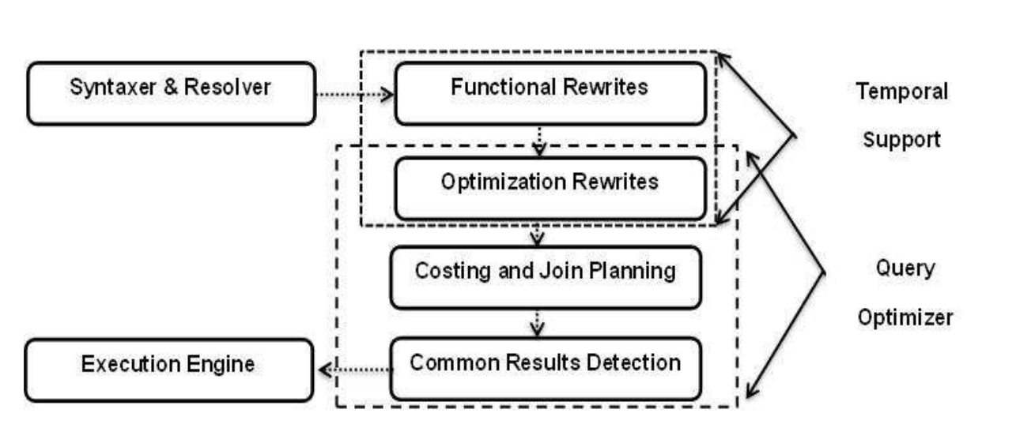
Temporal support in Teradata

Slide 33
Temporal constraints
Can be enforced at the level of each table and between tables.
Temporal constrains across tables represent temporal referential integrity
Temporal referential integrity can be flexibly defined with the child table being either temporal or regular table.
def
Notes:
http://delivery.acm.org/10.1145/2460000/2452443/p573-al-kateb.pdf?ip=122.180.198.220&id=2452443&acc=ACTIVE%20SERVICE&key=4D4702B0C3E38B35%2E4D4702B0C3E38B35%2E280D9278F484A59C%2E4D4702B0C3E38B35&__acm__=1544438014_e7a13621368e45d9bf2ef9f0df420c3c#URLTOKEN#
Table-level (e.g., check and unique) constraints are expressed by associating a temporal qualifier and time dimension with the defined constraint. For a valid-time table, a constraint can be defined as CURRENT, SEQUENCED, or NONSEQUENCED. A transaction-time table only allows a constraint to be CURRENT. Constraints on bi-temporal tables apply to rows that qualify in the validtime dimension and open in the transaction time dimension.

Slide 34
Other facts
Primary keys are not mandatory in Teradata whereas Primary Index is mandatory.
Data distribution is based on Primary Index value.
Primary keys doesn’t accept NULLs whereas Primary Index accepts NULL values.
Primary keys are unique whereas Primary Index can be either unique (UPI) or non unique(NUPI).
Primary keys doesn’t change whereas Primary Indexes change.

Slide 35
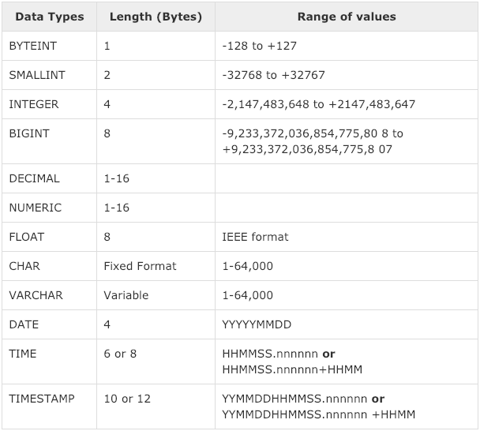
Data Types in Teradata
Notes:
https://www.tutorialspoint.com/teradata/teradata_data_types.htm

Slide 36
Thank You!

